Slide 1


Slide 2




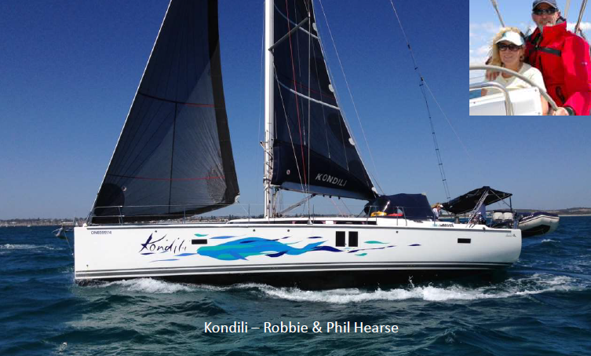














Slide 3

Agenda
1. Reminders & update Bill Henson
2. Q & A on preparation Bill Henson
3. Exmouth Gulf cruising Paul Browning
4. Discussion on cruising Paul Browning
5. Wrap-up Steve Parkinson

Slide 4
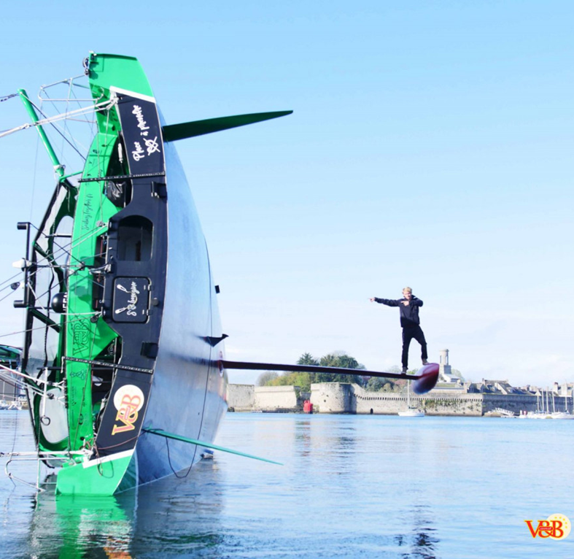
  1. Know how you will demonstrate stability
  ISO design category A or
  ORCi or
  SSSN calculated by RORC, cost ~ $90/boat
  Input data sheet available from the sailing office
  Physical test is not required!
  2. Book keel & rudder inspection
  (and rig inspection if required)
  Allow time for possible work
  3. Plan for 150 nm qualifying passage
  Can rally with the Bunbury return or Cape Naturaliste races, or sail independently
  50% of Exmouth crew on board

Slide 5
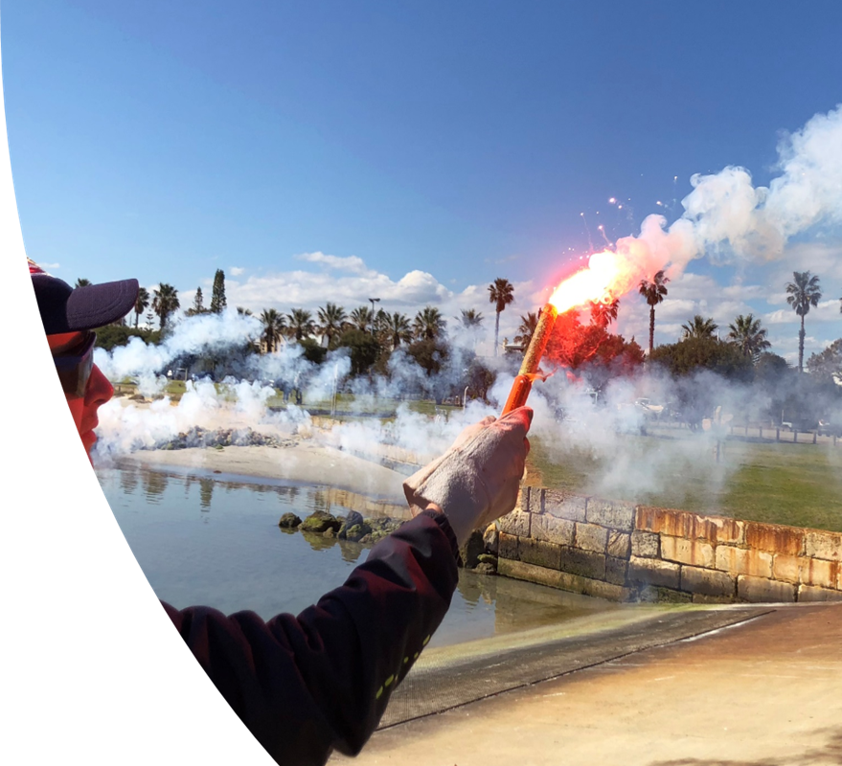
4. Book training, in particular sea safety & safety (SSSC)
First Aid, radio certificates also required
5. Book Exmouth marina
From ETA until Monday 15th May
Separate booking after 15th May
Complete information is not required for booking at this stage
Bring fenders & mooring lines
RIB will meet you outside the marina

Slide 6
Updated notice of race & rally have been issued
  Changes are marked up
  Requirements for 3 handed sailing have been clarified
  Please read the relevant notice
Planning for the container is progressing
  Will leave FSC ~ 1 week before start
  Use for dinghies, outboards, crew bags, cruising gear
  Will leave Exmouth after the results presentation
  Use for race sails, unnecessary crew

Slide 7

Strong interest from Exmouth school
Speakers required from early boats
Presentation dinner planning is well advanced
Whalebone Brewing are confirmed to supply BoA
BoA = Beer on Arrival!

Slide 8


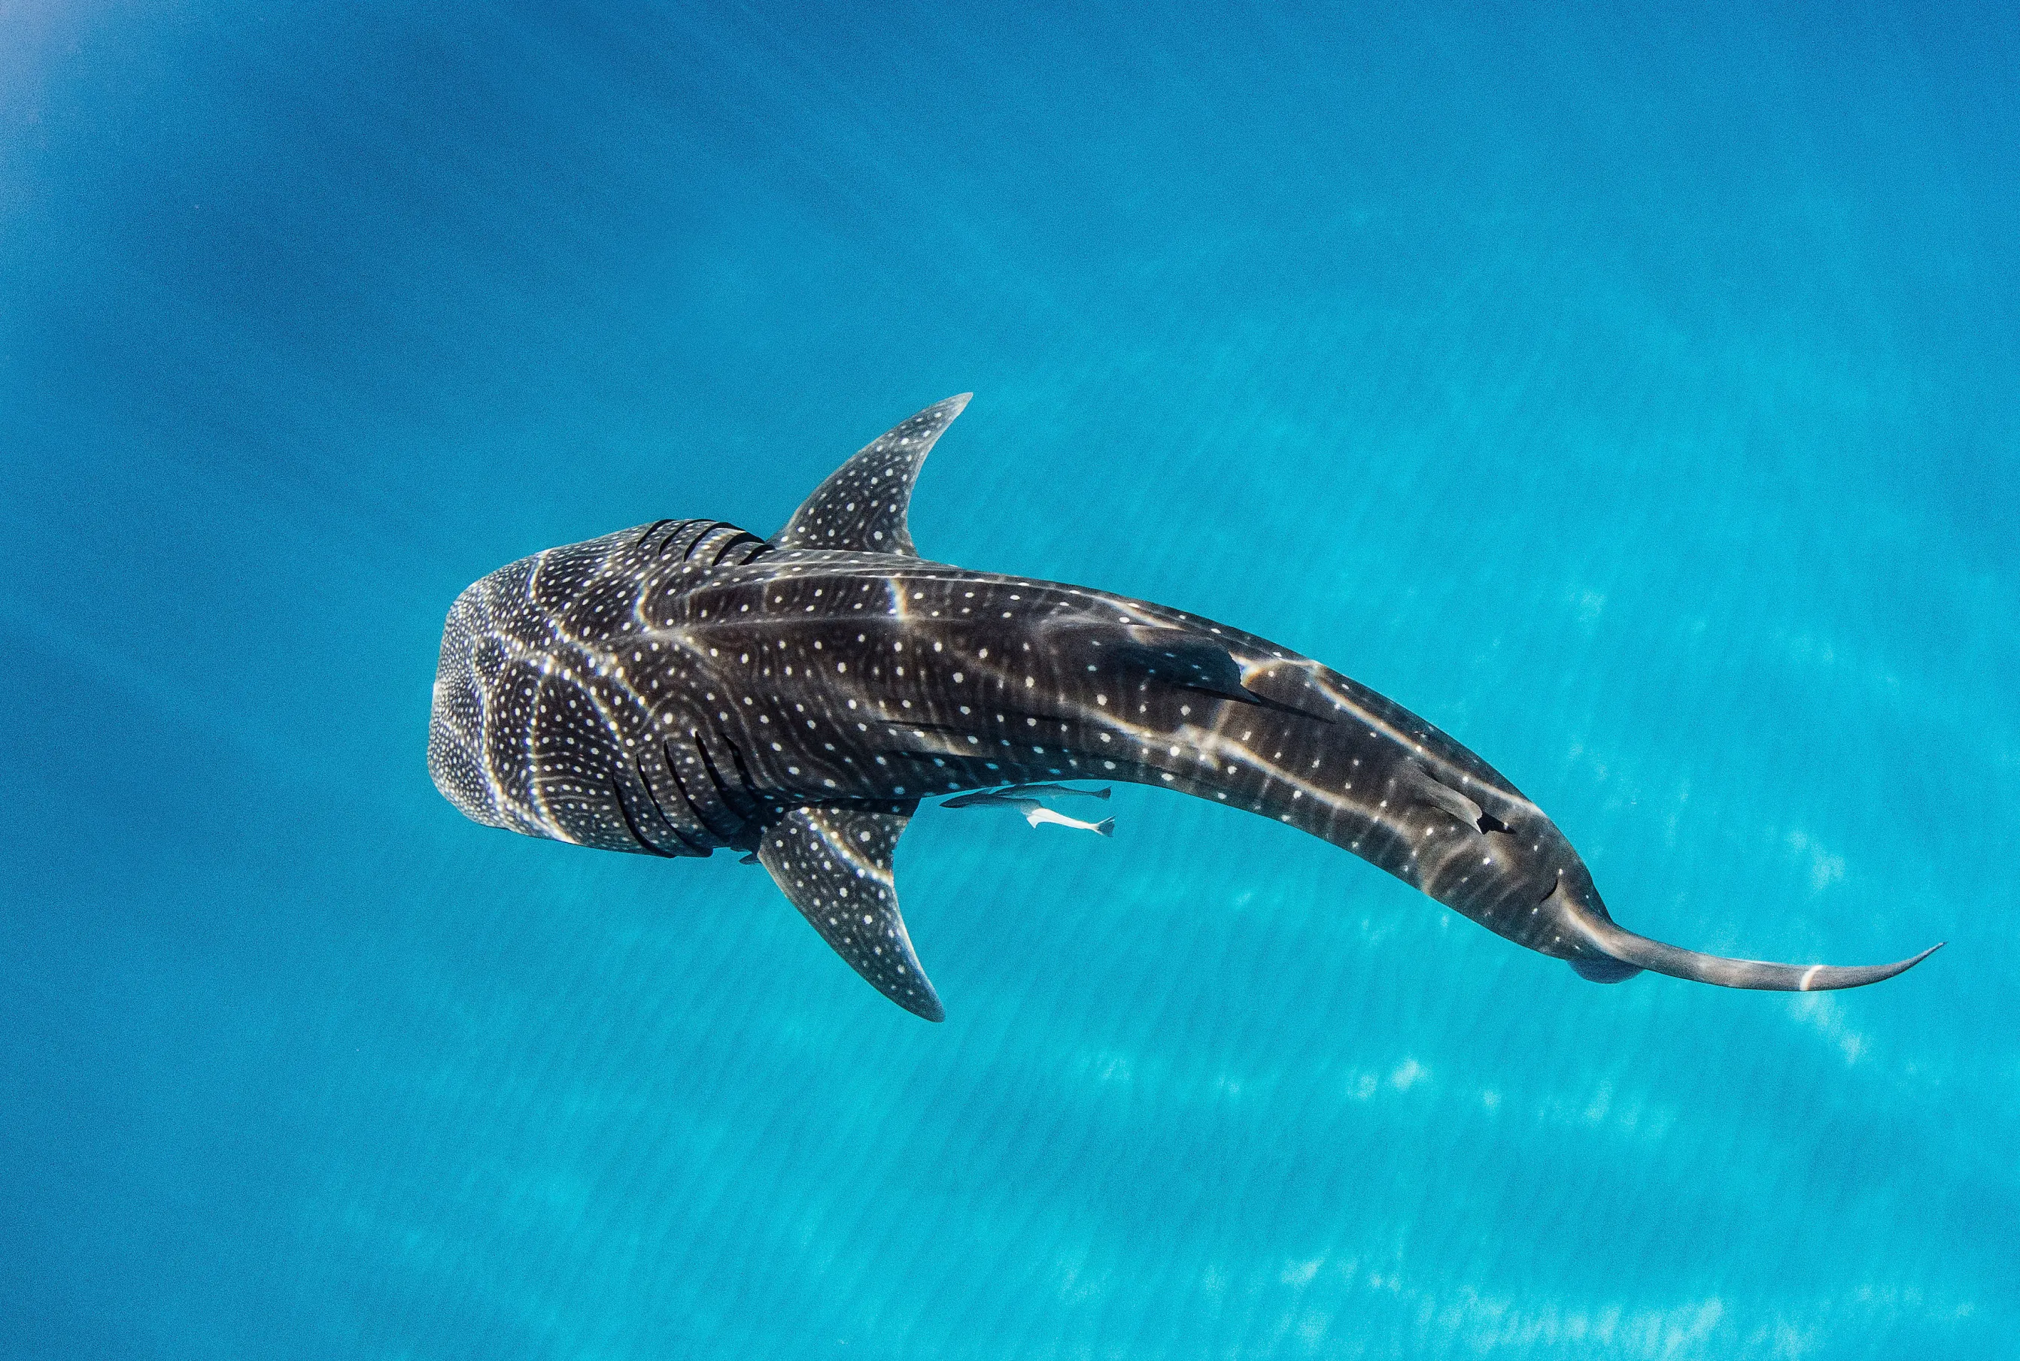
SPECIAL OFFER
$475 pp reduced to $425 pp
FRIDAY 12 MAY 2023
Both boats booked for FSC
(20 person per boats)
BOOK DIRECT NOW !

Slide 9
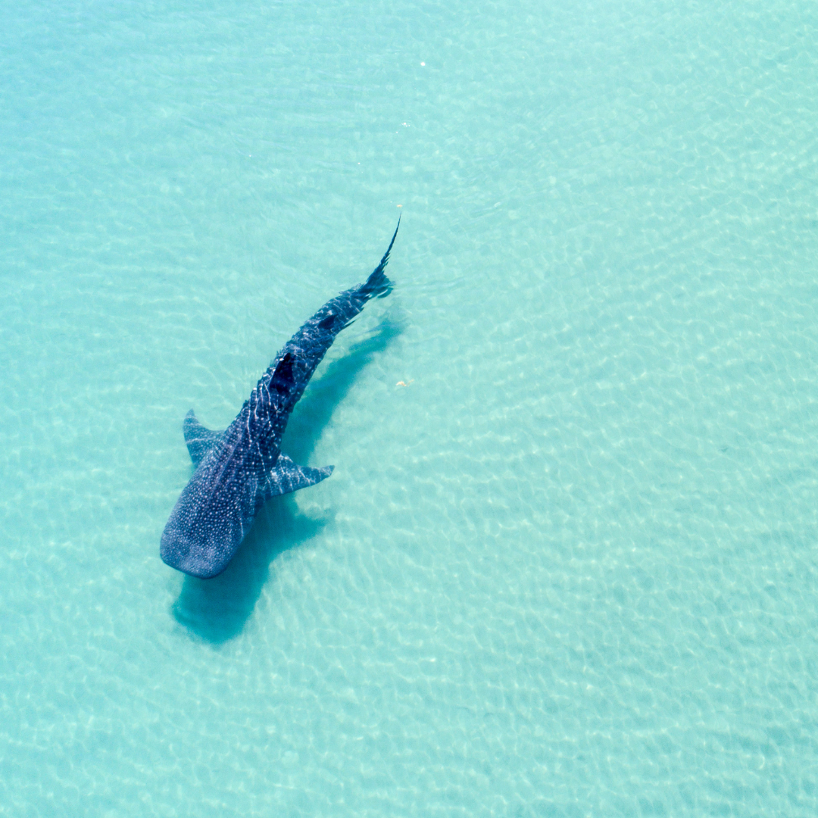
THANK YOU

